Slide 1
Naïve Bayes Classification
Dr. Uzair Ahmad

Slide 2
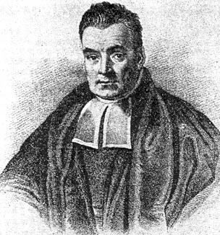
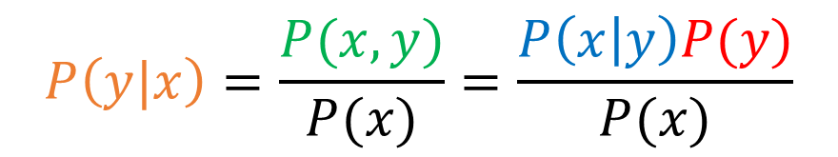
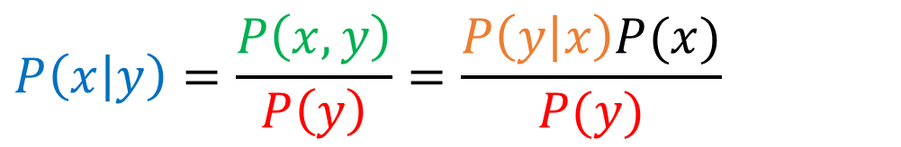
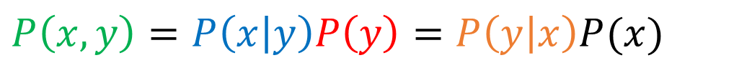
Naïve Bayes
$$P\left(x, y\right)=P\left(x | y\right)P\left(y\right)=P\left(y | x\right)P(x)$$
$$P\left(x | y\right)=\frac{P\left(x,y\right)}{P\left(y\right)}=\frac{P\left(y | x\right)P(x)}{P(y)}$$
$$P\left(y|x\right)=\frac{P(x,y)}{P(x)}=\frac{P\left(x | y\right)P(y)}{P(x)}$$
Thomas Bayes
1702-1761

Slide 3
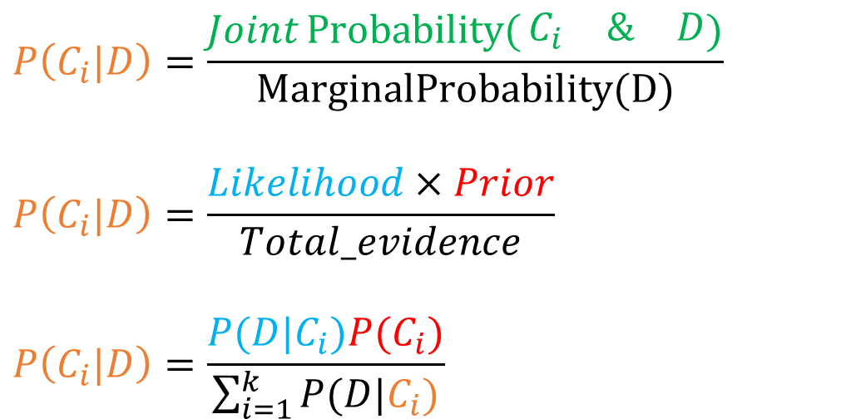
Naïve Bayes
$$P\left(C_{i}|D\right)=\frac{Joint\operatorname{Probability}{(}\begin{matrix}C_{i} & \& & D\end{matrix})}{\text{MarginalProbability}(D)}$$
$$P\left(C_{i}|D\right)=\frac{Likelihood×Prior}{Total_evidence}$$
$$P\left(C_{i}|D\right)=\frac{P(D|C_{i})P(C_{i})}{\sum_{i=1}^{k}{P(D|C_{i})}}$$
Thomas Bayes
1702-1761

Slide 4
Naïve Bayes
 |  | Spam
 |  | Spam | Not Spam | Total
Key Word “Free” | Exist | 35 | 3 | 38
 | Not Exists | 25 | 37 | 62
 | Total | 60 | 40 | 100
Contingency Table
Spam
No “free”
25
60
“free”
35
Probability Tree
pop
Not Spam
No “free”
37
40
“free”
3

Slide 5
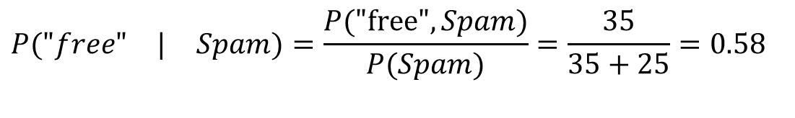
Naïve Bayes
 |  | Spam
 |  | Spam | Not Spam | Total
Key Word “Free” | Exist | 35 | 3 | 38
 | Not Exists | 25 | 37 | 62
 | Total | 60 | 40 | 100
Contingency Table
P(A|B) = (Joint Probability of A&B) / (Marginal Probability of B)
$$P(\begin{matrix}"free" & | & Spam)=\frac{P("\text{free}\text{"}, Spam)}{P(Spam)}=\frac{35}{35+25}=0.58\end{matrix}$$
$$P("\text{free}\text{"}, Spam)=P("\text{free}\text{" }| Spam) P(Spam) = 0.58 ∗ 0.60 = 0.35$$

Slide 6
Naïve Bayes
 |  | Spam
 |  | Spam | Not Spam | Total
Key Word “Free” | Exist | 35 | 3 | 38
 | Not Exists | 25 | 37 | 62
 | Total | 60 | 40 | 100
Contingency Table
$$P\left(Spam \right| "free")=\frac{Conut("\text{free}\text{"}, Spam)}{Count(free, spam)+count\left(\text{free}, NotSpam\right)}=\frac{count(x, y)}{\sum_{x^{′}}^{|V|}{count(x^{′},y)}}=φ_{x,y}$$
$$\begin{matrix}P\left(Spam \right| "free")=\frac{P("\text{free}\text{"}, Spam)}{P("free")}=\frac{35}{35+3}=0.92 & & \end{matrix}$$
$$P("\text{free}\text{"}, Spam)=P(Spam | "\text{free}\text{"}) P("free") = 0.92 ∗ 0.38 = 0.35$$

Slide 7
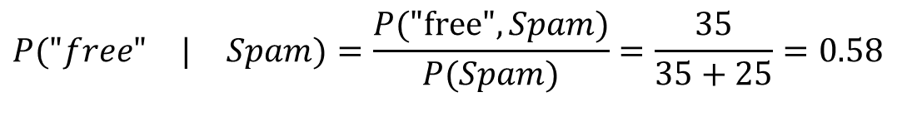
Naïve Bayes
Spam
No “free”
25
60
“free”
35
pop
Not Spam
No “free”
37
40
“free”
3
P(A|B) = (Joint Probability of A&B) / (Marginal Probability of B)
$$P(\begin{matrix}"free" & | & Spam)=\frac{P("\text{free}\text{"}, Spam)}{P(Spam)}=\frac{35}{35+25}=0.58\end{matrix}$$
$$P("\text{free}\text{"}, Spam)=P("\text{free}\text{" }| Spam) P(Spam) = 0.58 ∗ 0.60 = 0.35$$

Slide 8
Naïve Bayes
Spam
No “free”
25
60
“free”
35
pop
Not Spam
No “free”
37
40
“free”
3
P(A|B) = (Joint Probability of A&B) / (Marginal Probability of B)
$$\begin{matrix}P\left(Spam \right| "free")=\frac{P("\text{free}\text{"}, Spam)}{P("free")}=\frac{35}{35+3}=0.92 & & \end{matrix}$$
$$P("\text{free}\text{"}, Spam)=P(Spam | "\text{free}\text{"}) P("free") = 0.92 ∗ 0.38 = 0.35$$

Slide 9
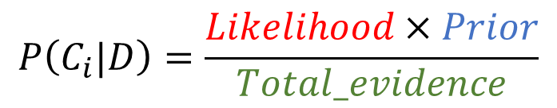
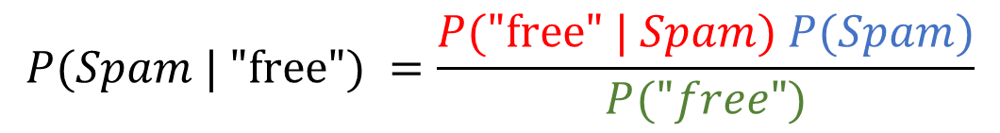
Naïve Bayes
$$P("\text{free}\text{"}, Spam)=P("\text{free}\text{" }| Spam) P(Spam)$$
$$P("\text{free}\text{"}, Spam)=P(Spam | "\text{free}\text{"}) P("free")$$
$$P(Spam | "\text{free}\text{"}) P("free") = P("\text{free}\text{" }| Spam) P(Spam)$$
$$P(Spam | "\text{free}\text{"}) =\frac{P("\text{free}\text{" }| Spam) P(Spam)}{P("free")}$$
$$P\left(C_{i}|D\right)=\frac{Likelihood×Prior}{Total_evidence}$$
Notes:
$$P("\text{free}\text{"}, Spam)=P("\text{free}\text{" }| Spam) P(Spam) = 0.58 ∗ 0.60 = 0.348$$
$$P("\text{free}\text{"}, Spam)=P(Spam | "\text{free}\text{"}) P("free") = 0.92 ∗ 0.38 = 0.349$$
$$P(Spam | "\text{free}\text{"}) P("free") = P("\text{free}\text{" }| Spam) P(Spam)$$
$$P(Spam | "\text{free}\text{"}) =\frac{P("\text{free}\text{" }| Spam) P(Spam)}{P("free")}=\frac{0.348}{0.38}=0.91578$$

Slide 10
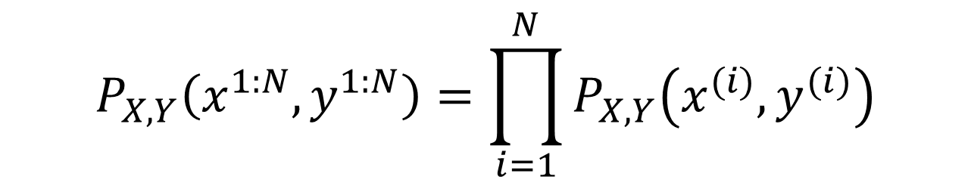
Naïve Bayes
Assumptions:
Bag-of-words
Independent & Identically distributed
$$P_{X,Y}\left(x^{1:N},y^{1:N}\right)=\prod_{i=1}^{N}{P_{X,Y}\left(x^{(i)},y^{(i)}\right)}$$
Notes:
the Joint Probability of the entire training data (N examples) is $\prod_{i=1}^{N}{p\left(x^{(i)},y^{(i)}\right)}$ given iid.
What $P_{X,Y}\left(x^{1:N},y^{1:N}\right)$ means is that random variables X and Y take specific values $x^{(i)},y^{(i)}$
iid allows joint probability of the entire dataset to be $p\left(x,y\right)=\prod_{i=1}^{N}{p\left(x^{(i)},y^{(i)}\right)}$
What we are trying to construct is a function
that returns the joint probability of given parameters.
- The joint probability distribution is governed by the parameters $θ$

Slide 11
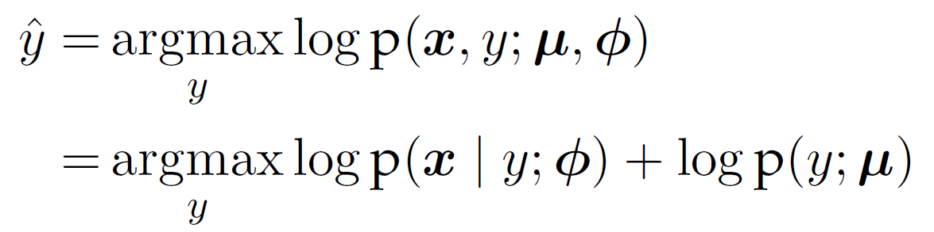
Naïve Bayes
Notes:
The Naive Bayes prediction rule is to choose the label y which maximizes log p(x; y; $μ$; $φ$):
We call Naive Bayes a generative model because we can read as stating
a kind of implicit assumption about how a document is generated:
first a class is sampled from P(c), and then the words are generated by sampling from P(x | y). (In
fact we could imagine generating artificial documents, or at least their word counts,
by following this process).
Naive Bayes calculations, like calculations for language modeling, are done in log
space, to avoid underflow and increase speed.

Slide 12
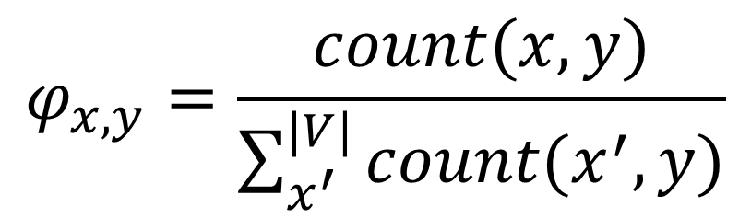
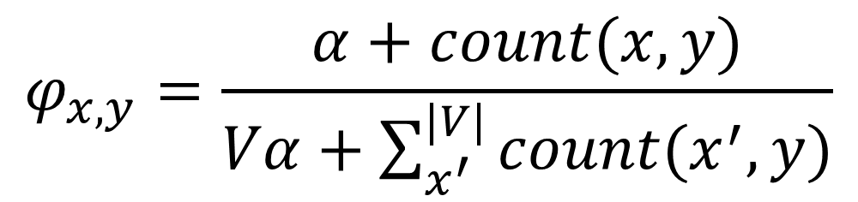
Training Naïve Bayes Classifier
$$φ_{x,y}=\frac{count(x, y)}{\sum_{x^{′}}^{|V|}{count(x^{′},y)}}$$
$$φ_{x,y}=\frac{α+count(x, y)}{Vα+\sum_{x^{′}}^{|V|}{count(x^{′},y)}}$$
Notes:
Estimating parameters empirically from training dataset.
$φ_{y,j}$ is the relative frequency estimate for word j in documents with label y. [what fraction of words in spam have word j in it]
$count\left(y, j\right)$ refers to the count of word j in documents with label y.
$count\left(y, j′\right)$ refers to the count of all words in documents with label y.
Note : it is crucial that the vocabulary V consists of the union of all the word types in all classes, not just the words in one class c (try to convince yourself why this must be true; see the exercise at the end of the chapter).
Problem of words not present in training data.
there are likely to be pairs of labels and words that never appear in the
training set,
It can be justified as maximum-likelihood estimate for $P_{X,Y}\left(x^{1:N},y^{1:N}; θ\right)$.
This is called Laplace smoothing. The pseudocount is a hyperparameter, because it
controls the form of the log-likelihood function, which in turn drives the estimation of $φ$
The corresponding estimate of $φ$ is called maximum a posteriori, or MAP. This is in
contrast with maximum likelihood, which depends only on the data.

Slide 13
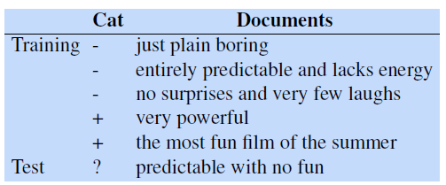
Example
V -ve = [Just, plain, boring, entirely, predictable, and, lacks, energy, no, surprises, very, few, laughs]
V +ve = [very, powerful, the, most, fun, film, of, summer]
V = [Just, plain, boring, entirely, predictable,
and, lacks, energy, no, surprises,
very, few, laughs, powerful, the,
most, fun, film, of, summer]
SLP, Chapter 4, p7
Notes:
Predictable: present in –ve , absent in +ve
No: present in –ve, absent in +ve
Fun: present in +ve, absent in -ve
With: Ignore words in Test that are not known in Training

Slide 14

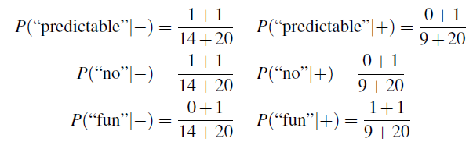
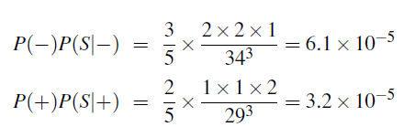
Example
Priors
Likelihood
Posterior
SLP, Chapter 4, p7
Notes:
Ignore words in Test that are not known in Training

Slide 15
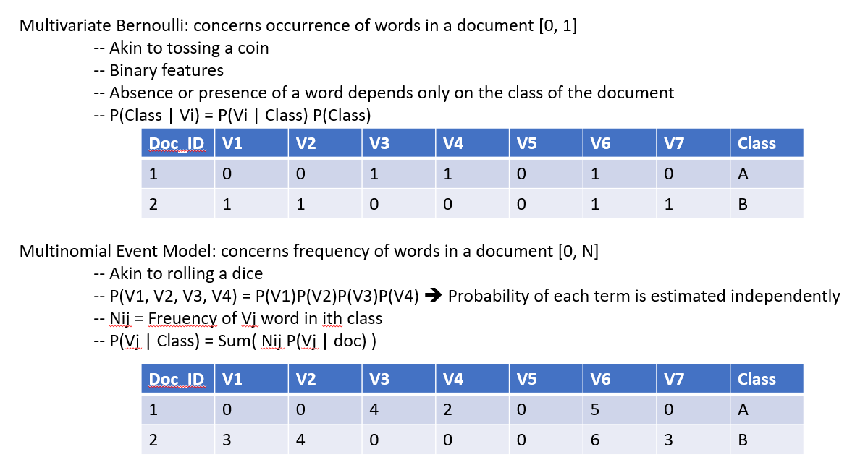
Binary Naïve Bayes:
Notes:
for each document we remove all duplicate words before concatenating
them into the single big document during training and we also remove
duplicate words from test documents.

Slide 16
Naïve Bayes: Negation features
Notes:
during text normalization, prepend the prefix NOT to every word after a token of logical negation (n’t, not, no, never) until the next punctuation mark.

